Slide 1
Lecture 21: Software Design Patterns
Mia Mohammad Imran

Slide 2
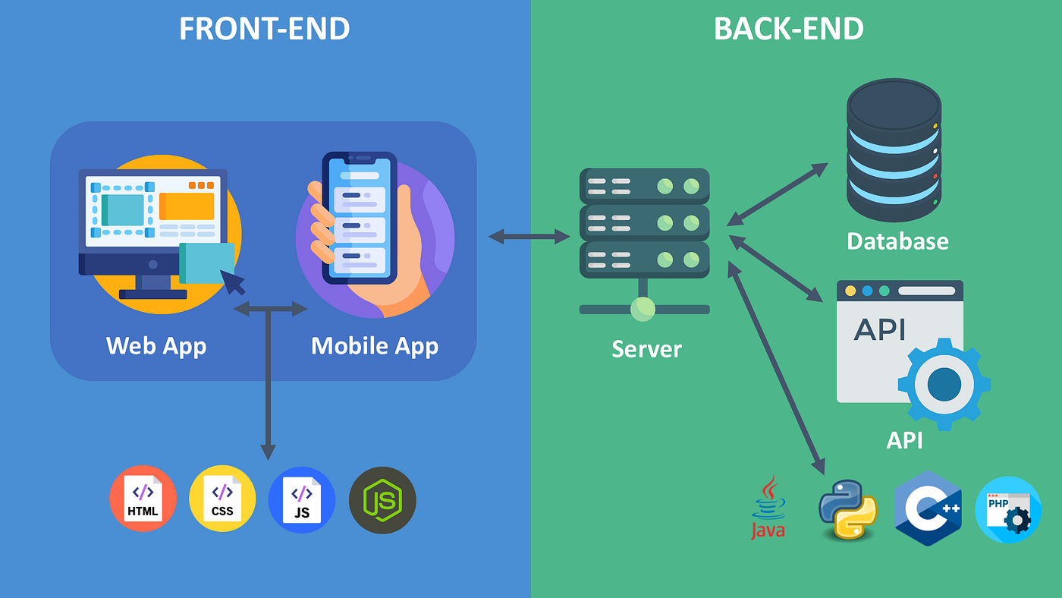

Recap: Full stack
Full stack: A set of technologies that fully encapsulate an application
Components:
Database
Notes:
Full stack development refers to the practice of working on both the client-side (frontend) and server-side (backend) of web applications.
This means managing the entire software stack, which includes both the technology that users interact with directly and the underlying server logic and databases that support that interface.
Key components of a full stack application include:
Frontend: The part of the web application that users see and interact with. This usually involves technologies like HTML, CSS, and JavaScript frameworks.
Backend: The server side that handles logic, database interactions, and server configuration. This typically includes programming languages like Python, JavaScript (Node.js), Ruby, etc.
Database: Where the application’s data is stored. Examples include SQL databases like MySQL, PostgreSQL, or NoSQL options like MongoDB.
Full stack developers have the flexibility to handle both the frontend and backend, making them valuable in building, deploying, and maintaining web applications.

Slide 3
Recap: Real-life stack architecture example from Google
FE
BE
DB
iOS FE
Metadata Storage
AFE (application frontend)
Data Storage Server
Web FE
Routing Server
Data Storage
Async
Android FE
Auditing Server
Activity Storage
Authorization Server
Notes:
This is a simplified version of an actual stack in use at Google.
Many other stacks within the company follow it closely as well.

Slide 4
Recap: Where are we now?
Lectures | Focus | Core Question
1-12 | SDLC basics, Ethics, Git, Code Review, Agile, User Stories and Requirement Analysis | What are the theoretical and practical background of software engineering?
13–14 | Code quality | How do we write code that lasts?
15–16 | Software Design principles | How do we write good code?
17–20 | Software Architecture & system design | - How do multiple components work together? How do systems scale and stay consistent?

Slide 5
Today’s Topic
Software Design Pattern

Slide 6
What are Software Design Patterns?
Why is an experienced designer more productive than a novice?

Slide 7
What are Software Design Patterns?
Why is an experienced designer more productive than a novice?
From experience, a designer builds up a repertoire of general solutions to problems that occur repeatedly
If experienced designers write down their solution structures then they can share them with others
If we agree on names for these solutions then we can use them to communicate ideas with other designers
Patterns are reusable solutions, not code

Slide 8
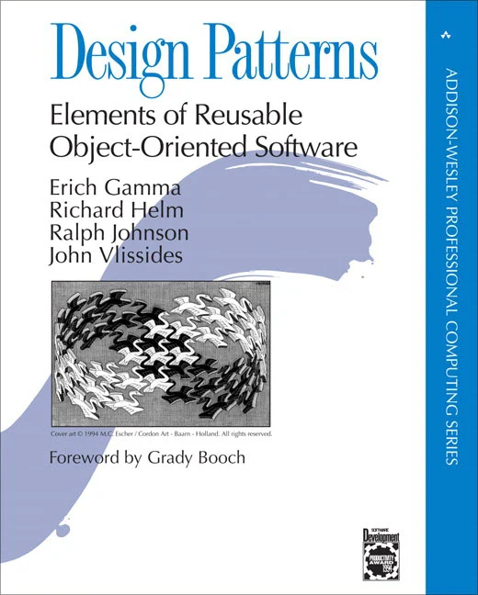

Gang of Four: Design Pattern
Published in 1994. Catalogued 23 design patterns

Slide 9
Example with a E-Commerce System
Presentation Layer
API Gateway
Application Layer
Data Layer
Infrastructure Layer
Presentation Layer → User clicks “Place Order” → Facade Pattern
API Gateway → Routes request to OrderService → Proxy Pattern → Handles authentication → Chain of Responsibility Pattern
Application Layer → Order state changes (State: Pending) → Observer/PubSub pattern
Data Layer → Order details saved in DB → Repository Pattern
Infrastructure Layer → Logs written → Singleton pattern

Slide 10
Recap: Principles That Patterns Implement
Design Principle (from L16) | Possible Patterns
Single Responsibility (SRP) | Strategy, Observer, Command
Open/Closed (OCP) | Factory, Decorator, Template Method
Liskov Substitution (LSP) | Adapter, Composite
Interface Segregation (ISP) | Strategy, Observer
Dependency Inversion (DIP) | Factory, Dependency Injection

Slide 11
Recap: Architectures
Context (L17-20) | Common Supporting Patterns
Layered Architecture | Factory (object creation), Facade (simplified interfaces)
MVC/MVP/MVVM | Observer (View listens to Model), Command (Controller actions)
Microservices | Strategy (replaceable service behaviors), Proxy (API Gateway)
Event-Driven Systems | Observer, Publisher-Subscriber, Command
Low-Cohesion Databases | Repository Pattern, Builder Pattern (query builders)
CQRS Systems | Command + Query Objects, Mediator, EventBus

Slide 12
Pattern Classification
Creational: Concerned with object creation mechanisms
Structural: Concerned with class and object composition
Behavioral: Concerned with object interaction and communication
Creational Patterns
Singleton
Factory Method
Abstract Factory
Builder
Prototype
Structural Patterns
Facade
Adapter
Decorator
Bridge
Composite
Flyweight
Proxy
Behavioral Patterns
Strategy
Observer
Command
Interpreter
Iterator
Mediator
Memento
State
Template Method
Visitor
Chain of Responsibility

Slide 13
Some popular SDPs
Singleton Pattern - The One instance that shall not be Duplicated!
Builder Pattern - IKEA manual of object creation; you might miss 1-2 screws still works!
Factory Pattern - “Alexa, make me a new instance.” → Greatest pattern of all time (Maybe 2nd greatest)!
Facade Pattern - “Pay no attention to the man behind the curtain.”
Adapter Pattern - The Rosetta Stone of design pattern!
Decorator Pattern - “Plugins, lots of plugins!”
Strategy Pattern - Prepare like Batman, always have a backup! → Greatest pattern of all time (definitely)!
Observer Pattern - One event to notify them all!
Publish-Subscribe (PubSub) Pattern - Observer pattern gone viral!

Slide 14
Have you seen/done something like this?
class Logger:
_instance = None
def __new__(cls):
if cls._instance is None:
cls._instance = super(Logger, cls).__new__(cls)
return cls._instance
log1 = Logger()
log2 = Logger()
print(log1 is log2) # True

Slide 15
Singleton Pattern
Ensures that only one instance of a class exists in the system and provides a global point of access to it.
Why it’s common: Many systems need shared access to configuration data, logging, or connections but creating multiple instances would cause conflicts or resource waste.
Example use cases:
Database connection pool
Logging service
Configuration manager
Cache manager

Slide 16
Have you seen something like this?
const query = knex('users')
.select('id', 'name')
.where('status', 'active')
.andWhere('age', '>', 18)
.orderBy('created_at', 'desc')
.limit(5).toString();
Glide.with(context)
.load("https://api.example.com/image.jpg")
.placeholder(R.drawable.loading)
.error(R.drawable.error)
.into(imageView);
var request = new HttpRequestMessageBuilder()
.WithMethod(HttpMethod.Post)
.WithRequestUri("https://api.example.com/data").WithJsonContent(new { Id = 1, Name = "John" }).Build();
request = (RequestBuilder()
.set_method('POST')
.set_url('api.example.com/users')
.add_header('Authorization', 'token12')
.set_json({'name': 'Alice', 'role': 'admin'}).build())

Slide 17
Builder Pattern
Separates the construction of a complex object from its representation. You can build different representations step-by-step using the same construction process.
Use Case:
ORM Query builder: building SQL statements dynamically through chained method calls → SQLAlchemy, JPA, etc
Configuration builder
Rest API request builder → API with header, payload, etc
GUI framework builder
Document builder → adding document summary, title, sections, etc
Email builder → adding email subject, body, cc, to, from, etc

Slide 18
Have you done something like this?
User user = new User();
User manager = new Manager();
User admin = new Admin();
Account account = new PersonalAccount();
Account checking = new CheckingAccount();
Account saving = new SavingAccount();

Slide 19
Factory Method Pattern
Defines an interface for creating objects, but lets subclasses or factories decide which class to instantiate
It decouples object creation from object usage
Use Case:
Choosing a payment gateway (PayPal, Stripe, Flutterwave) dynamically during checkout
Choosing a notification channel (email, mobile, push) etc

Slide 20
Factory vs Builder
Builder → step-by-step assembly → “How should I assemble this object?”
Factory Method → dynamic creation → “Which object should I create?”

Slide 21
Have you ever create a system like this?
Check Security
Process Order
Press Button (Say Create Order)
Process Payment
Send notification

Slide 22
Facade Pattern
Provides a simplified interface to a complex subsystem
Hides internal complexities so callers interact through one unified entrypoint
Reduces coupling between modules
Use Cases:
Common in layered architecture, SDK design, and APIs (e.g., payment gateway SDK)
Aggregating multiple backend services behind one endpoint
Media players that wrap encoding, decoding, buffering, and rendering
Benefit
Makes systems easier to use and reduces knowledge needed about underlying components

Slide 23
Facade Pattern Example
class HotelBookingFacade {
private AvailabilityService availability = new AvailabilityService();
private PaymentService payment = new PaymentService();
private ReservationService reservation = new ReservationService();
private NotificationService notification = new NotificationService();
public void book(String roomType, String guest, String email, String cardNumber, double amount) {
if (!availability.isAvailable(roomType)) {
System.out.println("Room not available");
return;
}
payment.pay(cardNumber, amount);
reservation.reserve(roomType, guest);
notification.sendConfirmation(email);
System.out.println("Booking completed");
}
}

Slide 24
Have any of you used to “Arrays.asList”
convert Array to List in Java?
String[] colors = { "red", "green", "blue" };
List<String> list = Arrays.asList(colors);
Basically: Wraps array with List interface

Slide 25
Adapter Pattern
Converts one interface into another that a client expects
Allows incompatible systems to work together
Often used for legacy system integration or third-party APIs
Avoids modifying existing code by adding a translation layer
Use Case:
Wrapping old data models to work with new interfaces
Integrating a legacy to a modern version
Converting a library’s API signatures into your app’s expected format
Benefit
Enables reuse of existing code regardless of interface differences

Slide 26
A good example here
https://www.servicenow.com/community/developer-forum/adapter-design-pattern-explained-practical-guide-for-servicenow/m-p/3353485

Slide 27
How many of you have used Java InputStream/something similar?
FileInputStream fis = new FileInputStream("/objects.gz");
BufferedInputStream bis = new BufferedInputStream(fis);
GzipInputStream gis = new GzipInputStream(bis);
ObjectInputStream ois = new ObjectInputStream(gis);
Some other Java functionalities like:
FileOutputStream → BufferedOutputStream, DataOutputStream, CheckedOutputStream
FileReader/FileWriter → BufferedReader, LineNumberReader, PushbackReader, PrintWriter
List → Collections.synchronizedList, Collections.unmodifiableList, Collections.checkedList

Slide 28
Decorator Pattern
Dynamically adds responsibilities or features to an object
Allows stacking multiple behaviors without modifying the original class
Promotes flexible and combinable extensions
Use Cases:
Adding logging, encryption, or caching to a service
Wrapping a basic report with timestamps, audit markers, or compression
UI components with dynamic styling and effects
Benefit
Extensible, non-intrusive enhancement of object behavior

Slide 29
Example
https://www.reddit.com/r/learnprogramming/comments/1c7iyyf/comment/l08h996/

Slide 30
Have you ever done something like this?
Comparator<Product> byPrice = (a, b) -> Double.compare(a.price, b.price);
Comparator<Product> byName = (a, b) -> a.name.compareTo(b.name);
Comparator<Product> byRating = (a, b) -> Double.compare(a.rating, b.rating);
List<Product> items = List.of(
new Product("Laptop", 999.0, 4.8),
new Product("Mouse", 25.0, 4.4),
new Product("Keyboard", 49.0, 4.6)
);
// Sort by price
items.sort(byPrice);
// Sort by name
items.sort(byName);
// Sort by rating
items.sort(byRating);
class Product {
String name;
double price;
double rating;
Product(String name, double price, double rating) {
this.name = name;
this.price = price;
this.rating = rating;
}
}

Slide 31
Strategy Pattern
Defines a family of interchangeable algorithms
Algorithm can be selected at runtime
Reduces conditional logic (if/else) in code
Encourages open extension and closed modification
Use Cases
Different sorting strategies based on dataset
Multiple authentication methods (OAuth, JWT, API key)
Payment processing strategies in e-commerce
Image compression strategies
Benefit
Behavior changes independently of the objects that use it
Greatest pattern of all time!

Slide 32
Observer Pattern
Allows one object (the subject) to notify multiple observers automatically when its state changes.
Coupling: Tight. Observers are directly registered with a specific subject instance.
Ideal for event-driven systems, notifications, and real-time updates (e.g., chat, stock prices, e-commerce orders)
Use cases:
UI components updating on data change
Event listeners in GUIs or microservices
Order notifications (email/SMS)
Communication: Synchronous. The subject directly calls observer methods when an event occurs
Typical Use Case: GUI frameworks, MVC architecture (view updates when model changes)

Slide 33
Observer Pattern
class Subject:
def __init__(self):
self._observers = []
def attach(self, observer):
self._observers.append(observer)
def notify(self, msg):
for obs in self._observers:
obs.update(msg)

Slide 34
Publish-Subscribe (PubSub) Pattern
Type: Messaging pattern (often implemented with middleware or brokers)
Coupling: Loose. Publishers and subscribers are decoupled via an intermediary (message broker or event bus)
[Publisher] → [Message Broker / Event Bus] → [Subscribers]
Publisher: Emits an event (e.g., "OrderPlaced")
Broker/Event Bus: Routes events to all interested subscribers
Subscriber: Reacts to the event (e.g., send email, update inventory)
When an order is placed:
Order Service publishes an order.placed event
Email Service and SMS Service each subscribe and react independently
Communication: Asynchronous. Messages may be buffered or distributed
Typical Use Case: Distributed systems, microservices, real-time event streaming
Message Brokers: Kafka, RabbitMQ, Redis Pub/Sub

Slide 35
Publish-Subscribe (PubSub) Pattern
class EventBus:
def __init__(self):
self._subscribers = {}
def subscribe(self, event_type, handler):
self._subscribers.setdefault(event_type, []).append(handler)
def publish(self, event_type, data):
for handler in self._subscribers.get(event_type, []):
handler(data)
def send_email(data):
print(f"Email sent to {data['user']} for order {data['order_id']}")
def update_inventory(data):
print(f"Inventory updated for order {data['order_id']}")
bus = EventBus()
bus.subscribe("order_placed", send_email)
bus.subscribe("order_placed", update_inventory)
bus.publish("order_placed", {"user": "Alice", "order_id": 101})

Slide 36
Case study: Baby/Pet Monitor App
Scenario: An Android/iOS app monitors a baby or pet through a camera device. The monitor automatically captures photos and sends them to the parent’s mobile client through a backend cloud service.
Goal: Automatic Capture and Delivery of Monitoring Photos
Actor | Role | Function
Camera Device / Monitor Node | Producer | Captures photo, triggers upload event
Backend Service (Cloud) | Coordinator | Stores image, manages events, notifies mobile clients
Parent/Pet Owner App | Consumer | Receives push notifications and displays new images

Slide 37
Applying Design Patterns: On the Camera Device
Pattern | Use | Benefit
Command Pattern | Encapsulate “capture photo” as a command that can be triggered automatically (motion detected, time interval). | Decouples photo-capture logic from trigger source.
Strategy Pattern | Select different capture strategies (e.g., motion-triggered, timer-based). | Easy to extend new capture strategies without altering core logic.
Observer Pattern | Notify the backend service or uploader when a new photo is available. | Enables asynchronous upload and integration with event-driven backend.
Factory Method | Create camera controller objects depending on hardware. | Supports multiple platforms with unified interface.

Slide 38
In the Backend Cloud Service
Pattern | Use | Benefit
Observer / PubSub Pattern | When a new photo upload event occurs, notify subscribers (e.g., push notification service, storage module, analytics service). | Decouples components; supports event-driven design from Lecture 20.
Repository Pattern | Encapsulate data access for photos, users, and notifications. | Isolates persistence logic; aligns with low-cohesion database design.
Builder Pattern | Construct complex metadata objects (photo info: timestamp, resolution, device ID, user ID). | Makes creation of structured data consistent and readable.
Proxy Pattern | Securely mediate communication between client app and cloud storage (e.g., signed URLs). | Improves security and performance.
Chain of Responsibility | Handle post-upload processing (virus scan → resize → store → notify). | Enables flexible and configurable processing pipelines.

Slide 39
In the Parent/Pet Owner App (Client Side)
Pattern | Use | Benefit
Observer Pattern | Listen for backend push notifications or WebSocket events (“NewPhotoAvailable”). | Enables real-time updates without polling.
Facade Pattern | Provide a simple API to manage notifications, downloads, and UI updates under one interface. | Simplifies complex subsystems for the UI layer.
MVC / MVVM Architectural Pattern | Separate UI (View), business logic (ViewModel/Controller), and data (Model). | Improves testability and maintainability.
State Pattern | Manage UI transitions (e.g., “Idle”, “Uploading”, “Displaying”, “Error”). | Ensures predictable UI behavior under network delays.

Slide 40
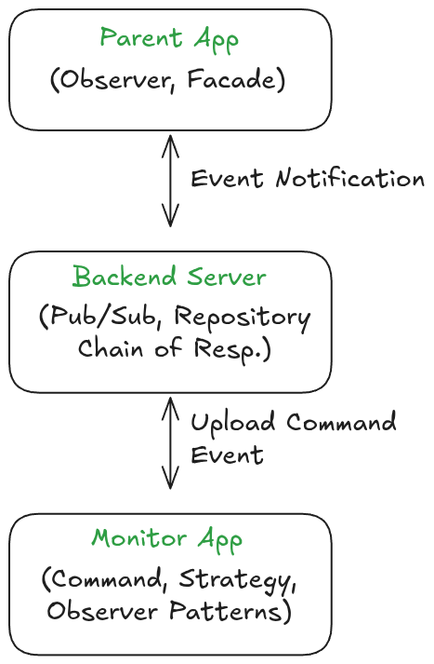
Overall Architectural Integration
Camera executes a CapturePhotoCommand (Command pattern)
Observer detects the new image and uploads to the cloud
Backend triggers PhotoUploadedEvent (PubSub pattern)
Notification service sends push to mobile app
Mobile app’s Observer receives update and refreshes UI
https://excalidraw.com/#json=o-BBQ05PRUIBqXyKR0sCT,lidFhMdqDegDzbeJPOrAHg

Slide 41
Class session 11/20 and Assignment 4
Class session 11/20
Talk a bit about software testing (very brief)
Project update
API design, db design, design patterns, implementation
Assignment 4
Implementation applying design patterns
Testing (unit testing, tdd, bdd)

